Slide 1
Literacy Learning: Explicit Instruction of Listening Skills Using Interactive Read Alouds
Learning
to
Listen
in
Primary
School
Reading Writing
Speaking
Dr. Donna Fogelsong
School of Education
Virginia Tech
Presentation to the ILA
June 2018
Balancing Literacy Instruction
Listening
Notes:
Tell me about yourself
I work with preservice teachers at two Universities - full time at VT/part time at RU - PreK-6 certifications - Public School: 17 years (3 years Reading - 1 Reading Recovery - 13 Classroom (k/first grade)
Research Interest: Providing preservice teachers and inservice teachers with strategies to improve listening skill instruction in the classroom

Slide 2
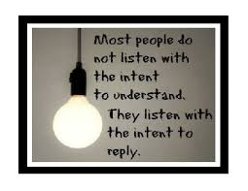
The Research Questions
What were teacher perceptions about teaching listening, and how did these perceptions influence the planning of read alouds in second-grade?
How did engagement in professional development impact teachers’ practices with listening instruction?
Notes:
Tell me what motivated you (lit review) - grad class (most people listen) doctoral class (dewey one way listening vs transactional listening
Vandergrift (2004) suggests educators who value listening need to begin “expanding from a focus on the product of listening (listening to learn) to include a focus on the process (learning to listen)” Rankin in the late 20’s; Nichols in the late 50’s, Duker - Wov Although 100 years of research reflects how listening saturates educational settings (Jalongo, 2008; Nichols, 1957; Rankin, 1928; Wolvin, 1984; 2010); most practicing teachers are unaware of the relationship between the research about listening instruction and its correlation to student success, or the need to teach students how to listen in the school environment.

Slide 3
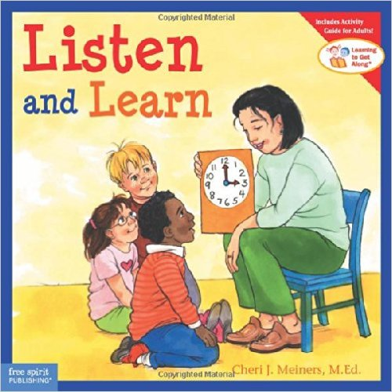
Overview of the Study
Children’s Literature – listening texts
JEPD - Job-embedded professional development
Specific Guidelines for teachers
Use Dyads - assigning students the role of listener and speaker for responding to questions
Use Whole Body Listening - to help promote students self-awareness of their listening behaviors
Notes:
So, what did you do? Who did you work with and what was the process? (Method)
researched children’s books on listening skills - implemented a JEPD with 4 2nd grade teachers (10 wks) met & planned bi-weekly (One of the teachers had a stroke half way through the study) - read alouds conducted weekly by teachers
collected pre/post interview data - (about listening habits/expectations/perceptions) teachers kept weekly journals about their listening skill instruction

Slide 4
JEPD during LSG Meetings
https://mccartheydressman.org
Notes:
bi weekly meetings - with collaborative planning- reflections - adjusted activities based on previous weeks practices - for example - they felt they stopped and started too many times during the read aloud - so we adjusted it to beg/mid/end questions with listening skill practice -
(they felt students were ‘losing’ the comprehension aspect - and I suggested we weren’t focusing on comprehension skills - rather we were focusing on improving their listening practices with their dyad partner) - but they couldn’t ‘not’ include more than one literacy skill

Slide 5
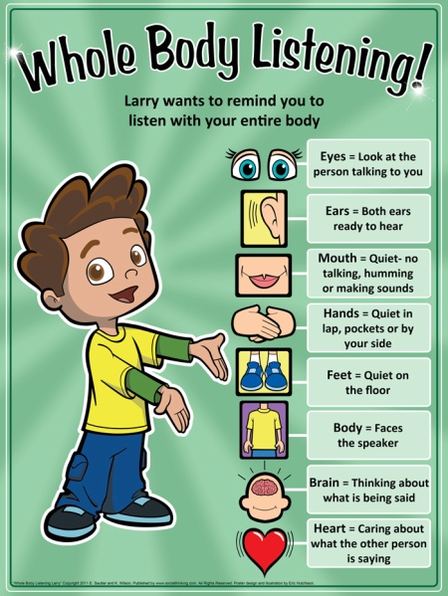
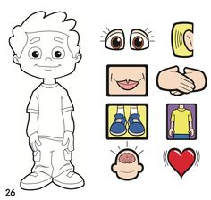
WHOLE BODY LISTENING
Most used Strategy
Motivated Teachers
Motivated Students
Reinforced Teachers Listening Expectations
Wilson, K., Sautter, E., & Hutchison, E. (2011). Whole
body listening Larry at school! San Jose, CA:
SocialThinking.com.
Notes:
whole body language became a crutch for the teachers - ‘ after initially giving the students practice with using whole body listening strategies - they quickly
reverted back telling not teaching (USE your WBL skills while I read the story)

Slide 6
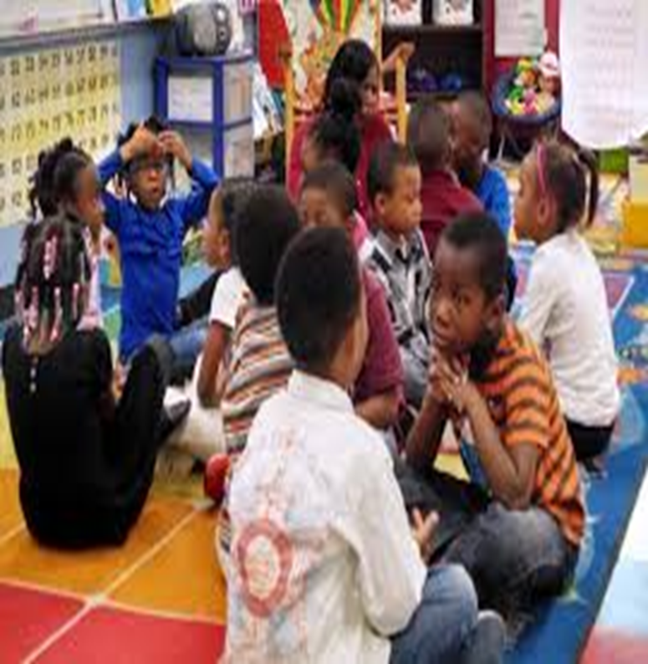
Dyad Strategies: DS
Set a purpose for listening
Prepare the students for listening
Authentic practice for students with listening
Funk and Funk (1989)
Notes:
three steps for the teachers to use when they were having the students use the dyads with their students (during the interactive read aloud)
they always did the first two parts - (listen for…. and use your WBL skills - but they didn’t always include the authentic practices part with their students -
I observed their read alouds (focusing only on their instructional practices) 3 times over the course of the 10 week study.

Slide 7
T
H E M E S
Barriers | Emotions | Self-Efficacy | Habits | Time | Planning
They thought they already taught listening | Frustration Not a quick fix Required teacher participation why change? | They felt they already taught listening | Tell students to listen | Rescheduling planning | Uncomfortable with listening section of the read aloud
Perceptions about student listening | Resistance Lack of knowledge and self-practice | A lack of immediate success | Trigger phrases | When/how long ‘just’ listening | Classroom management not literacy
Lack of background experiences | Lack of experiences | Lack of experience & training | Motivation | Motivation | Student- Teacher motivation
Time | Time | Hard to justify teaching ‘just’ listening | Multi- tasking Time | Include other content (time) | Time
Notes:
What did you find/what did/didn’t work - It’s hard to get teachers to value something that they haven’t been taught how to do - especially when they are otherwise successful in the classroom their perceptions are guided by ‘what they ‘see’ good listening to be’ WBL - using listening texts, raising awareness about Listening -

Slide 8
PARTICIPANTS FINAL REFLECTIONS
Mrs. Levine | Mrs. Sowers | Mrs. Tatum
“I feel I have taught them to listen, rather than told them.” | “ I didn’t really think about actually teaching listening skills before this. ” | “ I am more aware of student listening skills and use the language daily.”
Notes:
Summary of teachers comments - They felt like they already ‘taught’ listening in their final summaries - but felt that participating helped them be more aware of their need to ‘remind’ students to listen (not just at the beginning of the year
They continue to use the Whole Body Listening Larry Book at the beginning of each school year (2 years out) and create a poster with their students about WBL -

Slide 9
Improving awareness for all teachers that listening is a teachable construct
Teachers are essential role models for students as facilitators for learning to listen
Teachers emulate previous experiences and may need to unlearn previous habits
Implementation of consistent active listening strategies within classrooms
Studies with practicing teachers that enable ongoing practice/education/professional development First with just teachers to help develop listening capacity strategies and skills Then transition into the classroom with students
Practices and strategies for teaching how to teach students to listen versus telling them to listening
Conclusions
Notes:
what do teachers need to know -

Slide 10
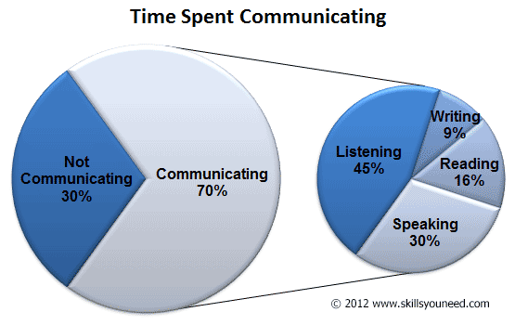
THE COMMUNICATION OF LISTENING
Further research will lead us from a disjointed circle of instruction to a more balanced approach with all of these literacy skills explicitly and consistently taught in all classrooms.
Notes:
How do we balance the curriculum -
we can include listening skills practice across the school day - but there needs to be times set aside weekly for students to practice explicit listening skills - just like they do in reading/ writing

Slide 11
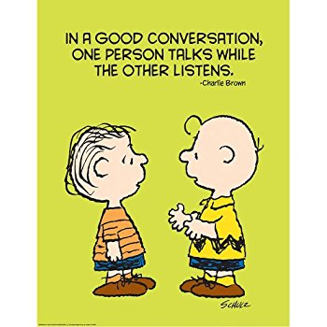
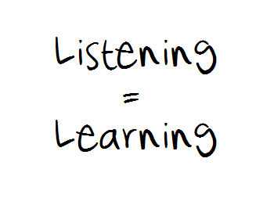
The Next Step
New Study: How are Primary Teachers’ Teaching Listening?
Listening Instruction in Pre-Service Teacher Coursework
How do we build up listening stamina/literacy -
Contact Information:
daltizer@vt.edu
https://donnafogelsong.weebly.com/
Notes:
Plans for the future
help teachers encourage good conversations with their students - not just talk “TO” them - but engage in talking “WITH” them

