Slide 1
International Listening Association Webinar Series Balancing Literacy Instruction: Teaching Listening in the Elementary Classroom
Guest: Donna Fogelsong
Hosted & Produced by Laura Janusik
Technical Direction by Phil Tirpak

Slide 2
Host & Producer Laura Janusik, Ph.D., MBA
Professor at Rockhurst University, Kansas City
Consultant
http://listeningtochange.com/
Research Areas: Listening Cognitions, Metacognitions, and Pedagogy
ILA Member since 1998
President 2010-2011

Slide 3
Technological Moderator & Guru Phil Tirpak
Instructor of Communication Studies, Northern Virginia Community College
Virginia Master Teacher
Specialty Area: Listening and Student Success
ILA President 2015 - 2016

Slide 4
ILA Webinar – Tips
We will mute/unmute all microphones
Use “Chat” to comments and questions.
On chat screen control panel please enable your questions to be seen by Host only.
Upon leaving, click on End Meeting
Enjoy!

Slide 5
Guest Speaker Donna Fogelsong, Ph. D., M.A.,
Ph.D. in Curriculum and Instruction from Virginia Tech; Listening Specialty
Now teaches in the Elementary Education program at Virginia Tech
Previously taught kindergarten and 1st grade , plus Reading Recovery and Title I Reading Teacher
Don’t tell students to listen; teach them how!
Email: donnafogelsong@vt.edu
Website: https://donnafogelsong.weebly.com

Slide 6
Balancing Literacy Instruction: Teaching Listening in the Elementary Classroom
Writing
Reading
Balancing Literacy Instruction
Speaking
Listening
Donna Fogelsong
ILA WEBINAR: NOVEMBER 29, 2018
Notes:
Providing preservice teachers and inservice teachers with strategies to improve listening skill instruction in the classroom

Slide 7
How can helping students listen more effectively in the classroom help improve classroom management?
Notes:
As teachers, we all want that classroom where everyone follows the directions the first time ---
we have all been or heard that teacher who sounds like Charlie Browns teacher --- all I have to do is say the Charlie Brown’s teacher and most of us will hear -- WAHWAHWAH…
How do we transition from being Charlie Brown’s teachers – maybe it requires two things – one for us as teachers to be more direct, more specific (using less words to tell students what our expectations are, but then also – giving students the opportunity to learn how to listen in the environment of schools. ask for others who might be interested in researching this

Slide 8
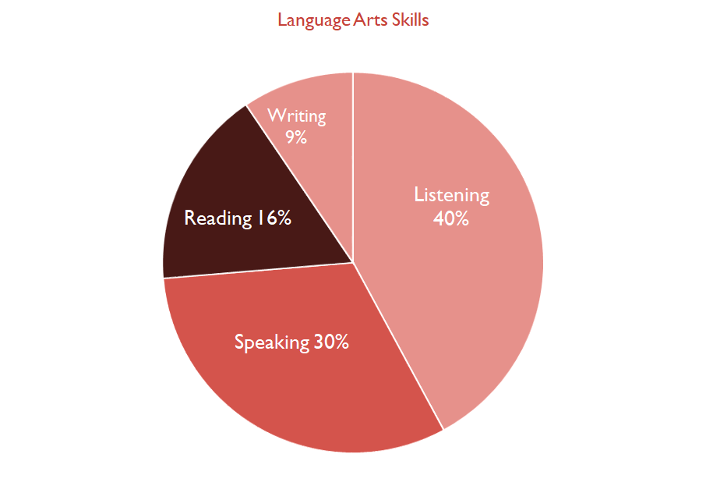
Notes:
Overall school day -- what it looks like for a student; since the majority of a students day is spent in either listening or speaking – maybe it is time to look at how we address the most used literacy skill - listening

Slide 9
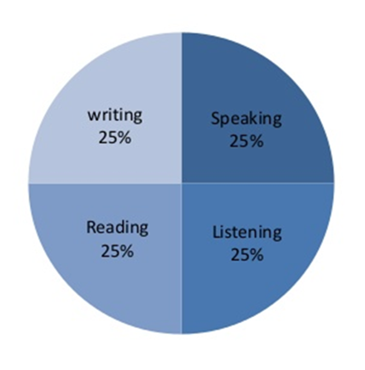
Four Skills
A Balanced Curriculum
Fogelsong, 2016
Notes:
How do we balance the curriculum in the classroom
we can include listening skills practice across the school day - but there needs to be times set aside weekly for students to practice explicit listening skills - instruction on the most used skill set that students use
should be planned and explicitly taught throughout the day. We need to transition toward a more balanced approach that integrates the core literacy skills throughout the curriculum, especially during the language arts block of instruction. I advocate this ---

Slide 10
Teaching Listening - Bridging the Gap
The first literacy skill students use
home vs classroom
Notes:
Listening is the first literacy skill that our students learn -- they learn to listen through being part of the conversation-- part of the environment
In school, students require a different set of listening skills which teachers haven’t been taught how to include in their curriculum-- it is assumed that students know how to listen,
teachers need to be aware of their own habits with regards to listening and to understand their own expectations for students listening.
how do we bridge the gap? we have to begin with teachers -- listening is a literacy skill that students need to practice -- this can be done throughout different instructional times during the day

Slide 11
Steps for beginning listening instruction
Step 1
Set a purpose
Step 2
Prepare students
Step 3
Authentic practice
Notes:
We will go over one method with specific strategies for incorporating listening instruction in your classroom with specific opportunities for students to practice listening in authentic settings.
Begin with WBL -- then Funk & Funk’s strategy for teaching listening which includes setting a purpose, preparing students to listen and then using Step Three where we give students authentic practice with listening to each other by incorporating the Dyads (partners listening to each other)

Slide 12
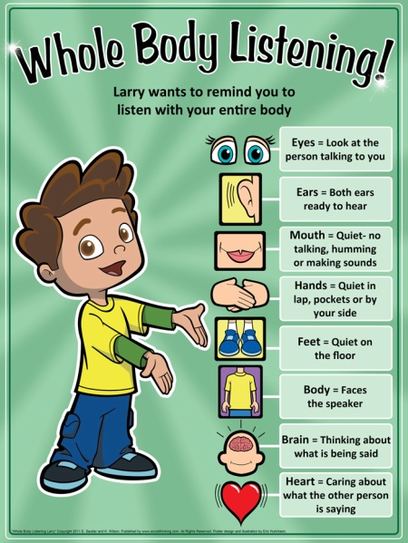
Step One
Wilson, K., Sautter, E., & Hutchison, E. (2011). Whole body listening Larry at school! San Jose, CA:SocialThinking.com
Notes:
How many of you have heard of using your whole body listneing ? You can have a -- discussion with students -- depending on the age group -- you can have students make their own Larry -- you can make a ‘class Larry’ or you can have a premade poster already --
helping students become more self-aware of what they are doing when they are listening -- what do they do? This also means you as a teacher will need to model whole body listening for your students as well. You will be the model for the students to imitate – think aloud modeling

Slide 13
Step Two
Step 1
Set a purpose
Step 2
Prepare students
Step 3
Authentic practice
Funk and Funk (1989)
Notes:
these steps will require explicit directions for the students and specific practice by the students -- teacher modeling will also be necessary to help students understand how not to interrupt the speaker - examples and nonexamples will be helpful for the students to see -- so let’s talk about each of the specific steps

Slide 14
Teachers Role
Be purposeful & specific
Why are they listening?
Set a purpose for listening
Notes:
read alouds -- three steps for the teachers to use (during the interactive read aloud) Set a purpose, like making predictions or asking questions about the cover - nothing new here -- most teachers do this already, we are just moving toward a more
Explicit model of implementing listening instruction into the read alouds --- giving the students a purpose for listening - for example if you were reading Charlotte’s Web – students might be given the purpose to listen for what happens when Fern runs out to the barn in the first chapter. Now the students are listening for something while you read – they have a goal, a purpose for listening

Slide 15
Teacher’s Role
Clear expectations
WBL – review
Student’s Role
Students paraphrase
Prepare the students for listening
Funk and Funk (1989)
Notes:
This seems a little backward doesn’t it – you have given the students a purpose, and now you are going to prepare them --- its’ okay – they now have their motivation to listen, next you can prepare them to listen by asking them to remind you what their job is as a listener – they can even ‘practice’ telling a partner and then sharing with the whole class. Giving them 30 seconds to share their ideas and then asking a few of the groups to share – (you can even make it more challenging after they have practiced doing this a few times by having them tell you what their partner shared) Whole body listeningo you want studetns to restate or to paraphrase? Perhaps this is where you introduce paraphrasing as a verbal listening technique?
-Janusik, Laura

Slide 16
Teacher Role
Ask questions
Monitor students
Students Role
Practice listening to each other using Dyads
Authentic practice for students with listening
Notes:
Practice will include talking to each other about their responses to the question while you monitor them - . Remind them their purpose for listening
Pose some questions to them for practicing talking to each other (A, B partners) Listening in to see if both partners are doing their role,
listening to their partner without interrupting and discussing the topic
Remember – the goal of this is specifically for practice with listening skills – when teachers do a guided reading lesson – one of the most important aspects is for students to have the mini lesson and then practice using the skill – the same is true of listening – students have to actively practice using the skill in order to become better listeners.
Switch roles and have them practice again

Slide 17
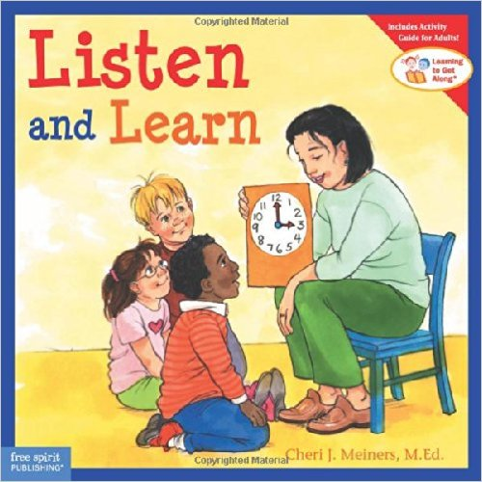
https://donnafogelsong.weebly.com/
Notes:
Here are some books that I would recommend using to start – books that actually are about using listening skills – the weebly page also has more resources listed as well --- read alouds --- after students practice their listening skills and become more efficient -- you can talk to them about ‘verbal listening’ where students are more accountable for their own understanding of the speaker’s intentions
students can paraphrase the speaker’s words in order to clarify

Slide 18
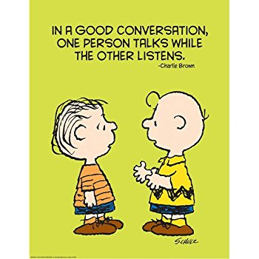
Content Areas
Cooperative Learning (Kagan & Kagan, 2009) & Teaching Listening
Examples:
Literature Circles –
Language Arts
Jigsaw –
Social Studies
Give One: Get One -
Math
Numbered Heads -
Science
Notes:
Here are some books that I would recommend using to start – books that actually are about using listening skills – the weebly page also has more resources listed as well --- read alouds --- after students practice their listening skills and become more efficient -- you can talk to them about ‘verbal listening’ where students are more accountable for their own understanding of the speaker’s intentions
students can paraphrase the speaker’s words in order to clarify

Slide 19
What questions do you have?
Cooperative Learning (Kagan & Kagan, 2009) & Teaching Listening
Notes:
Here are some books that I would recommend using to start – books that actually are about using listening skills – the weebly page also has more resources listed as well --- read alouds --- after students practice their listening skills and become more efficient -- you can talk to them about ‘verbal listening’ where students are more accountable for their own understanding of the speaker’s intentions
students can paraphrase the speaker’s words in order to clarify

Slide 20
Balancing Literacy Instruction: Teaching Listening in the Elementary Classroom
Writing
Reading
Balancing Literacy Instruction
Speaking
Listening
Notes:
Teaching listening would help to promote a more balanced approach to literacy instruction and ultimately a side benefit would include improved classroom management because students would be more aware of when they were and weren’t listening – you would be more confident in reminding them of the explicit expectations for listening to your directions. classroom management and listening require two different sets of expectations
classroom management is something the teacher monitors and reminds students to do --- listening is a literacy skill that students need to learn to improve -- like reading, writing, and speaking – they can improve their ability to listen just like they can improve their ability to read or write; they just need to be given more opportunities to be taught and to practice it –They need it modeled. One of the things I often tell my preservice teachers is that you can’t hold a student accountable for something that you have not taught them -- using a read aloud to start giving students opportunities to see listening modeled, be aware of how to listen, and practice using listening skills -- can help improve students capacity to be good listeners… and who doesn’t want that? They can move beyond hearing WAH WAH WAH and you are no longer Charlie Brown’s teacher when you are teaching!
.

Slide 21
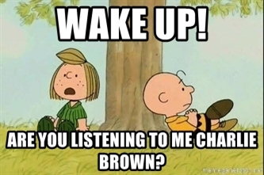
Resources
https://donnafogelsong.weebly.com/
Kagan, S., & Kagan, M. (2009). Cooperative Learning. San Clemente, CA: Kagan Publishing.
Kagan structures https://sirblois.files.wordpress.com/2016/09/cooperative-learning-activities.pdf

Slide 22
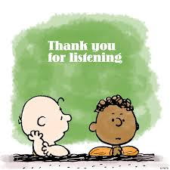
Resources
Whole Body Listening Resources:
https://www.socialthinking.com/Products/Whole%20Body%20Listening%20Larry%20at%20School%202nd%20Edition
Wilson, K., Sautter, E., & Hutchison, E. (2011). Whole body listening Larry at school! San Jose, CA:SocialThinking.com.
Email:
donnafogelsong@vt.edu

